Slide 1
TOWERS OF HANOI

Slide 2
Tower of Hanoi is the most common recursive problem
The objective is to shift all disk from peg A to Peg C using Peg B.
The shifting of disks is restricted by following rules:
Only one disk can be shifted at a time.
Only top disk on any peg may be shifted to any other peg.
At no time can a larger disk be placed on a smaller disk

Slide 3
Tower of Hanoi
For 3 Towers and 3 Disks

Slide 4
Tower of Hanoi

Slide 5
Tower of Hanoi

Slide 6
Tower of Hanoi

Slide 7
Tower of Hanoi

Slide 8
Tower of Hanoi

Slide 9
Tower of Hanoi

Slide 10
Tower of Hanoi
Explicit Pattern
Number of Disks Number of Moves 1 1 2 3 3 7 4 15 5 31
Formula for finding the Total no. of moves with respect to the no. of disks: (2^n -1)

Slide 11
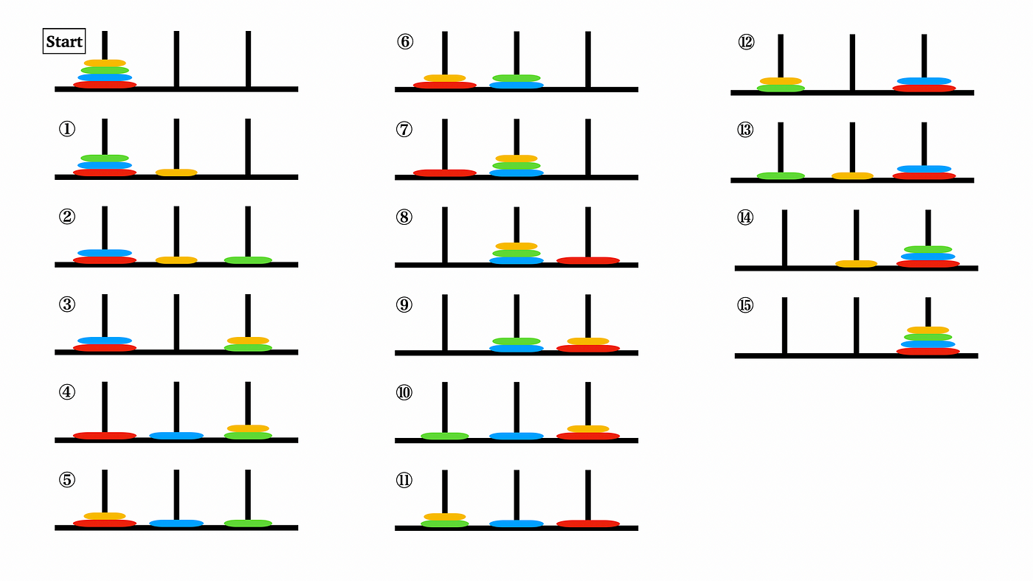
Tower of Hanoi
For 3 Towers and 4 Disks

Slide 12
Recursion by using Stack

Slide 13
Example:
T(n)
{
if(n>0)
{
T(n-1);
printf(“%d”, n);
}
}
int main()
{
T(3);
}
Recursion: When function call itself again and again. Activation State = N+1

